Slide 1
Pre – PETS
Training
Pre – PETS
Training
Section 1 – Rotary International
Section 2 – The District
Section 3 – Being President
Section 4 - Membership
Section 1 – Rotary International
Section 2 – The District
Section 3 – Being President
Section 4 - Membership
D7780 - Dick Hall
D7850 - Mike Carrier
D7870 - John Siemienowicz
D7890 - Joanne Alfieri
D7910 - Cliff Rober
D7930 - Terry Rezendes Curran
D7950 – William “Billy” Roberts
D7980 - Jeff Krause
Terry Curran
District Governor 2021-2022
1

Slide 2
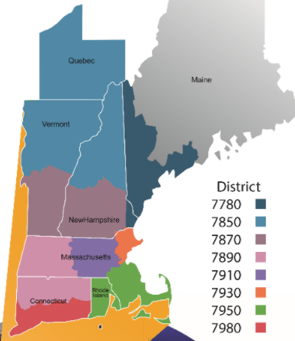
Pre-NE PETS Objectives
Vision Statement & Strategic Plan
Rotary International structure
Annual Goals
RI President, RI 2021-22 Theme
Foundation and Grants
Public Relations, Public Image, Rotary Brand
What goals do you need to set in Club Central?
Membership
Service
Foundation
Youth
2

Slide 3
Rotary Vision Statement

Slide 4
RI Strategic Plan
PRIORITY 1 Increase Our Impact
People of Action are effective problem-solvers.
Assess the needs of the community
Join together to help make improvements.
PRIORITY 2 Expand Our Reach
People of Action activate and inspire one another.
Our impact is larger when more people unite with us.
People appreciate our ambitious, compassionate, and inclusive spirit
Our stories give people hope that the world can change for the better
Invite others to join us
Build connections and opportunities to share our passion

Slide 5
RI Strategic Plan
PRIORITY 3 Enhance Participant Engagement
People of Action strive to understand the needs of others.
People need to feel seen and heard.
People are seeking experiences that feel personally and professionally relevant and fulfilling.
Seeing our dedication, people are eager to join and go the distance with us
Commit to putting the needs, expectations, and growth at the center of all we do.

Slide 6
RI Strategic Plan
PRIORITY 4 Increase Our Ability to Adapt
People of Action are inventive, entrepreneurial, and resilient.
We excel at finding new ways to lead the world to lasting change.
We have proven that we know how to help organizations of every kind
Seek out fresh opportunities, create more paths to leadership, open up our conversations to diverse voices, and simplify how we operate
Stay true to ourselves and stay ahead of change.

Slide 7
The Four Way Test
Of the things we think, say or do
Is it the TRUTH?
Is it FAIR to all concerned?
Will it build GOODWILL and BETTER FRIENDSHIPS?
Will it be BENEFICIAL to all concerned?

Slide 8
Rotary International Diversity and Inclusion Statement
As a global network that strives to build a world where people unite and take action to create lasting change, Rotary values diversity and celebrates the contributions of all backgrounds, regardless of their age, ethnicity, race, color, abilities, religion, socioeconomic status, culture, sex, sexual orientation, or gender identity.

Slide 9
The Object of Rotary
The Object of Rotary is to encourage and foster the ideal of service as a basis of worthy enterprise and, in particular, to encourage and foster:
First. The development of acquaintance as an opportunity for service;
Second. High ethical standards in business and professions; the recognition of the worthiness of all useful occupations; and the dignifying of each Rotarian’s occupation as an opportunity to serve society;
Third. The application of the ideal of service in each Rotarian’s personal, business, and community life;
Fourth. The advancement of international understanding, goodwill, and peace through a world fellowship of business and professional persons united in the ideal of service.

Slide 10
Rotarian Code of Conduct
As a Rotarian, I will:
Act with integrity and high ethical standards in my personal and professional life
Deal fairly with others and treat them and their occupations with respect
Use my professional skills through Rotary to mentor young people, help those with special needs, and improve people’s quality of life in my community and in the world
Avoid behavior that reflects adversely on Rotary or other Rotarians
Help maintain a harassment-free environment in Rotary meetings, events, and activities; report any suspected harassment; and help ensure non-retaliation to those individuals that report harassment

Slide 11
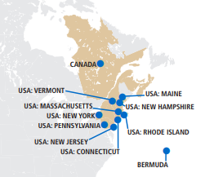
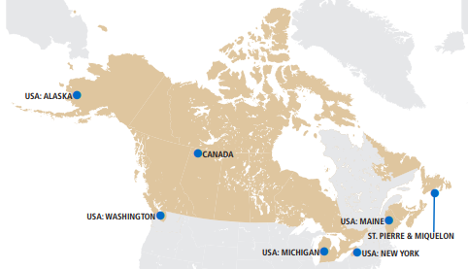
Rotary International Structure
Rotary International is an association of rotary
clubs.
34 Zones, 535 Districts, 35,000 Clubs
1.2 million Rotarians
The purpose of Rotary International is to support the clubs and districts in their pursuit of programs and activities that promote the object of rotary.
The role of the district is to provide support to the clubs, provide training to Rotarians, and to promote the object of Rotary.
Rotary Board of Directors are chosen for a two-year term from Zone 28 and Zone 32, alternating between each zone.
Zone 32
Zone 28
11

Slide 12
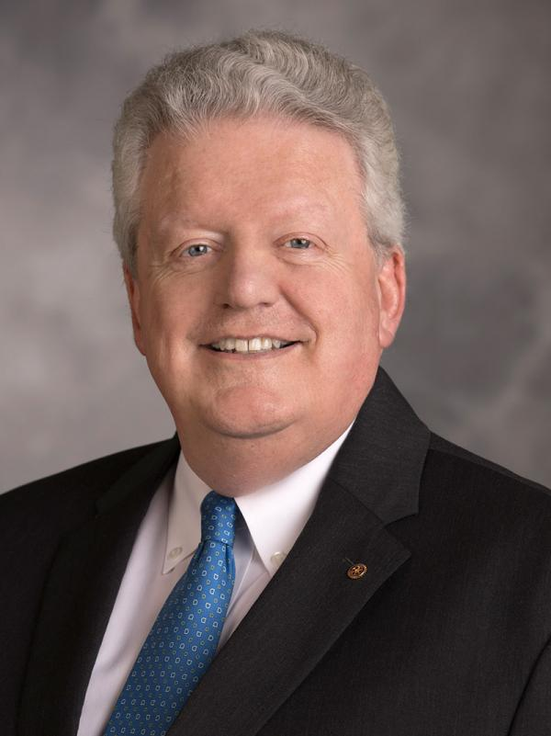
Rotary Annual Goals 2019-2020
Support and Strengthen Clubs
Retain current members.
Increase Current club membership.
Start new clubs.
Increase the number of female members, members under 40 and Rotaractors joining Rotary.
Focus and Increase Humanitarian Service
Increase cash and district DDF contributions to End Polio Now.
Increase local and international district grants and global grants funded with DDF.
Encourage Interact and Rotaract clubs to engage in service projects – including project for the environment – with their local Rotary Club and community.
Increase contributions to the Annual Fund, and build the Endowment Fund to $2.025 billion by 2025.
Enhance Public Image and Awareness
Publicize the role of Rotary and Rotarians in polio eradication.
Build awareness of Rotary and promote the People of Action Campaign.
Increase awareness of Rotary Club Projects by using Rotary Showcase and Rotary Ideas and creating a club history.
Rotary President Mark Maloney
2019-2020

Slide 13
Calls To Action 2020-2021
RI President Holger Knaack defined his year of Opportunities:
That we develop acquaintances and that our relationships with each other and the people we serve be thoughtful, meaningful, relevant and impactful.
That we work at retaining our current membership
That we incorporate creative thinking to serve virtually
That we incorporate creative thinking for fundraising and support of our mission to eradicate Polio
That we can build capacity by growing Rotaract, Interact, and RYLA.
That we explore avenues to include more Diversity, Inclusion and Equity into our clubs and District.
These Actions are not about changing, but about being transformative.

Slide 14
Introduction of new RI Theme
14

Slide 15
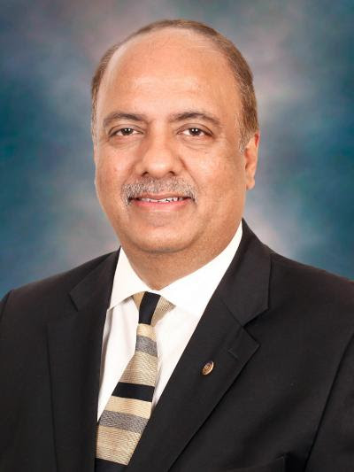
2021 - 2022 ROTARY INTERNATIONAL PRESIDENT
Shekhar Mehta

Slide 16
2020-21 Theme: New 2021-22 theme to be announced in February 2021

Slide 17
Rotary PresidentialCitation
17

Slide 18
Rotary Citation – 2020-21
To achieve the citation:
• Go to Rotary Club Central
• Review the 25 available goals
• Select at least 13 goals
• Achieve those goals
• Report achievement in Rotary Club Central
Notes:
All of this material will change after your International assembly
Dick-The PrePets training will be done before IA, so this comment does not apply.

Slide 19
Rotaract Citation – 2020-21
To achieve the citation:
• Go to Rotary Club Central
• Review the 22 available goals
• Select at least 12 goals
• Achieve those goals
• Report achievement in Rotary Club Central
• Submit nomination by August 15

Slide 20
Interact Citation – 2020-21
To achieve the citation:
• Go to Rotary Club Central
• Review the 20 available goals
• Select at least 11 goals
• Achieve those goals
• Report achievement in Rotary Club Central
• Submit nomination by August 15
Notes:
All of this material will change after your International assembly
Dick-The PrePets training will be done before IA, so this comment does not apply.

Slide 21
Foundation & Grants
21

Slide 22
Mission and Motto since 1917
The mission of The Rotary Foundation is to enable Rotary members to advance world understanding, goodwill, and peace through the improvement of health, the support of education, and the alleviation of poverty.
The Rotary Foundation’s motto is Doing Good in the World.
Foundation programs are supported solely by voluntary contributions from Rotarians and friends of the Foundation who share its vision of a better world.

Slide 23
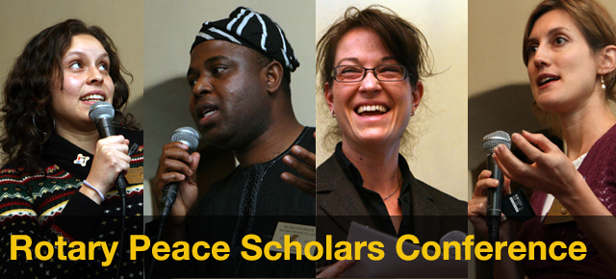
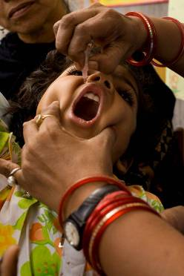
Rotary Foundation Programs
Rotary Peace Centers

Slide 24
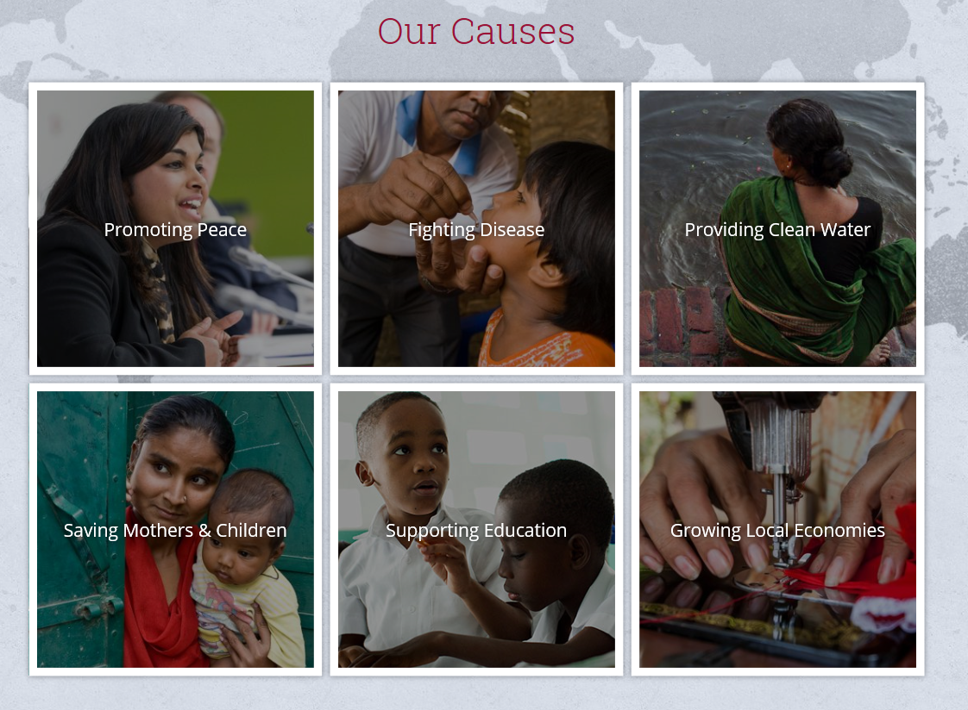
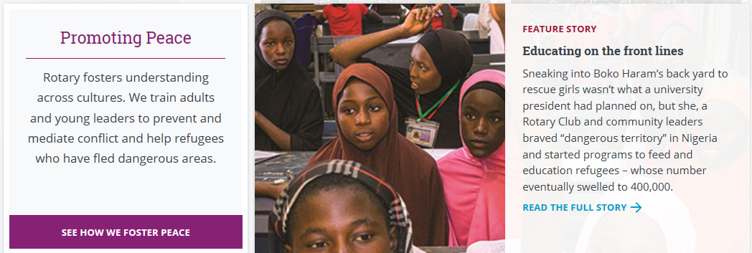
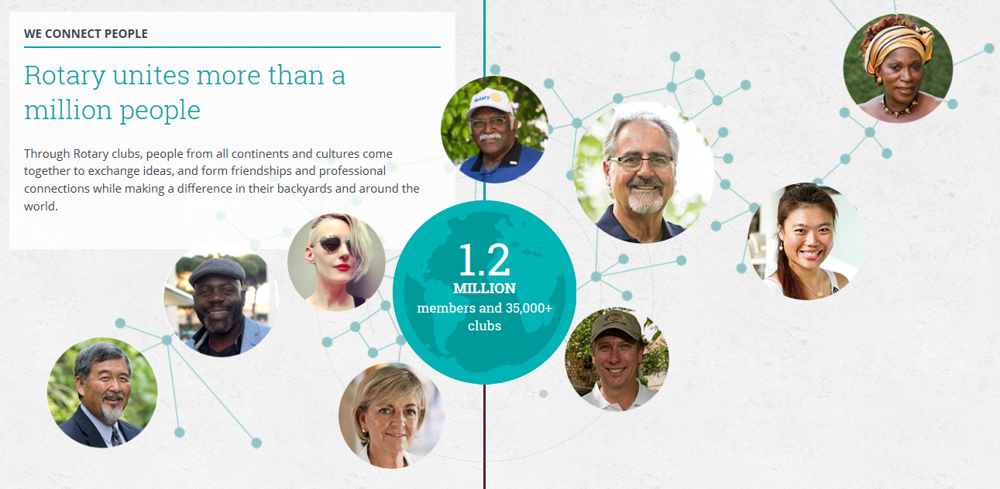
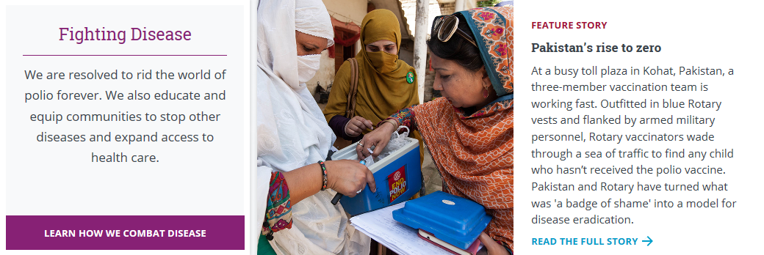
Six Areas of Focus

Slide 25
New Seventh Area of Focus

Slide 26
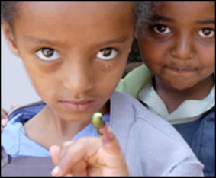
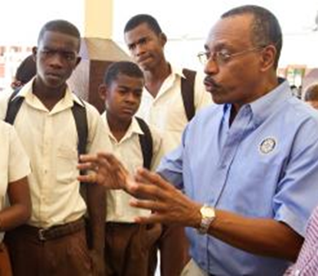
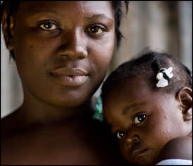
SUPPORTING THE ROTARY FOUNDATION
PolioPlus Fund
End Polio Now
Annual Fund
For Support Today
Endowment Fund
To Secure Tomorrow

Slide 27
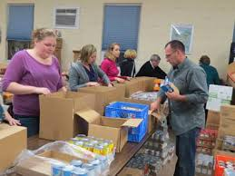
THE ANNUAL FUND
Primary funding source for Foundation grants and activities which include District and Global Grants
Supports local and international grants through the SHARE system
Contributions are credited to donor’s club and applied to club’s goal

Slide 28
GRANT FUNDING 2021-2022… 7780
Annual Fund Share 2018-2019
$222,379
2021-2022
50% World Fund
$111,189
50% DDF
$111,189
Global Grants
$55,594
District Grants
$55,594
67

Slide 29
GRANT Funding for 2021-2022
District | Annual Fund Donated 2018-2019 | District Designated Funds | Global Grants | District Grants
7780 | $222,379. | $111,189. | $55,594. | $55,594.
7850 | $119,752. | $54,328. | $27,164. | $27,164.
7870 | $134,909. | $67,454. | $33,727. | $33,727.
7890 | $186,000. | $93,000. | $46,500. | $46,500.
7910 | $127,140. | $63,570. | $31,785. | $31,785.
7930 | $187,556. | $93,776. | $46,888. | $46,888.
7980 | $358,669 | $179,334. | $89,667 | $89,667.
D7950 chooses not to share this information with the other districts of NEPETS

Slide 30
GRANT QUALIFICATION 2021-2022
Send at least one member to the Grant Management Training.
Input your club’s Foundation goals into Club Central on rotary.org by July 1, 2021 (not required by all districts).
Complete two documents: TRF Club MOU & the District Addendum (if you have one). Club Presidents for 2020-21 and 2021-22 must sign both documents. Check with your District for snail mail address.

Slide 31
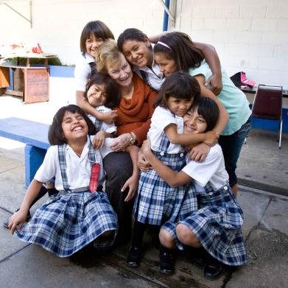
THE ENDOWMENT FUND
Gifts to the Endowment Fund are held in perpetuity. They are professionally invested, with a portion of the earnings used each year for purposes specified by the Trustees and the donors.
The Endowment Fund offers donors a way to create their own lasting legacy through Rotary.
The Endowment helps fund the Peace Centers.
Named endowed funds may recognize gifts of $25,000 or more.

Slide 32
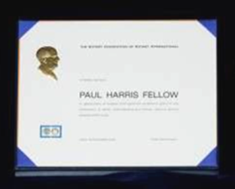
INDIVIDUAL RECOGNITION: PAUL HARRIS FELLOW
A person who contributes $1,000 to the Annual Fund, Polio Plus or an approved Global Grant or in whose name $1,000 is contributed

Slide 33
INDIVIDUAL RECOGNITION: PAUL HARRIS SOCIETY MEMBER
Contributes $1,000 each year to the Annual Fund, Polio Plus, or approved Global Grants

Slide 34
INDIVIDUAL RECOGNITION: BENEFACTOR
Provision in estate plan bequeaths minimum $1,000 to The Rotary Foundation
An outright gift of $1,000
to the Endowment Fund

Slide 35
INDIVIDUAL RECOGNITION: BEQUEST SOCIETY
Provision in estate plan totaling $10,000+ Examples: living will, life insurance policy

Slide 36
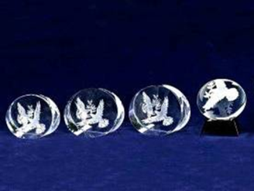
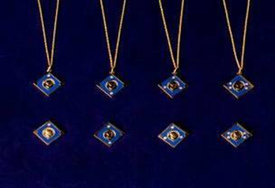
INDIVIDUAL RECOGNITION: MAJOR DONOR
Personal outright or cumulative gifts of $10,000+
Cash, life income agreements, bequests, real estate, or securities

Slide 37
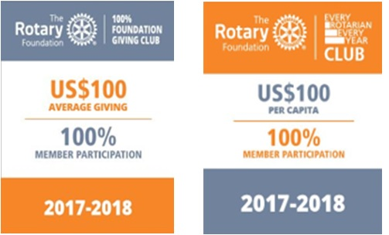
CLUB BANNER RECOGNITIONS
Average of $100 in per capita giving and every contributes at least $25 to Annual Fund, PolioPlus Fund, approved global grants, or Endowment Fund.
Minimum Annual Fund contribution of $100 per capita and every member personally contributes at least $25 to the Annual Fund during the year.

Slide 38
CLUB BANNER RECOGNITIONS
Every member contributes a minimum of $1,000 to the Annual Fund, PolioPlus, or global grants within a Rotary year
All members are Paul Harris Fellows. This is a one-time recognition.

Slide 39
ROTARY FOUNDATION
Every Rotarian Every Year
(EREY)
A minimum Annual Fund contribution of $100 per capita during the Rotary year, and every dues-paying member must personally contribute at least $25 to the Annual Fund during the year.

Slide 40
Resources
https://my.rotary.org/en/learning-reference/about-rotary/strategic-plan
https://my.rotary.org/en/take-action/apply-grants/district-grants
Terms and Conditions for Rotary Foundation District Grants and Global Grants
Community Assessment Tools (PDF)
Lead Your District: Rotary Foundation Committee manual (PDF)
District Grant Lifecycle (PDF)
How to use the Grant Center (PDF)
A Guide to Global Grants (PDF)

Slide 41
Public Relations Public Image Rotary Brand
41

Slide 42
Public Relations / Public Image
Club Public Image Chair / Social Media
Your Club websites
Twitter & Instagram Club Accounts
Club Facebook Page
Rotary offered materials (Rotary Club Central)
Your club branding / Signature Community events

Slide 43
Six Social Media Resolutions To Get Your Club Noticed
1. Be consistent – Post regularly and often
2. Develop a social media schedule
3. Mix it up
4. Develop a strategy
5. Establish guidelines
6. Have FUN

Slide 44
Public Image
Plan how to use communications strategies to achieve your public image goals
Consider how to create and implement both an internal and external communications plan for your club
Use the public image resources available to enhance your communications efforts

Slide 45
Rotary Public Image Coordinators
Helpful tips
Pick your Communications Chair
Help your Club Chair build a Committee
Train your members and club

Slide 46
Rotary Public Image Coordinators-Zone 32
Can help you and your Club:
Assist with public image goals
Training at all levels
Provide resources

Slide 47
Public Image Committee
Each club should have a public image committee that:
Attends your district public image seminar.
Develops a public image plan, then set and achieve public image goals.
Promotes club activities and projects among club members, local media outlets, and members of your community.
Use the resources in the Brand Center to enhance Rotary’s public image.
Makes sure club communications follow Rotary’s guidelines for voice and visual identity.
Uses the People of Action campaign materials to increase public understanding of Rotary and drive engagement in your community.
Enhances projects and activities to make them more appealing to the media.

Slide 48
Public Relations Committee
In many clubs, members serve on a committee for three years, so it’s likely that some current committee members will continue into your term. If you need to fill any openings, work with the president-elect to find someone with experience in at least one of these areas:
Advertising, Marketing
Public relations
Media relations
Public speaking
Writing, or photography
Social media
Website development
Event planning

Slide 49
Public Relations / Public Image
Club Public Image Chair / Social Media
Your Club websites
Club Facebook Page
Rotary offered materials (Rotary Club Central)
Your club branding / Signature Community events

Slide 50
Four Avenues for Success
Increased visibility
Increased membership and contributions
Engaged members
Partnerships and support for local projects

Slide 51
Target Audience

Slide 52
Rotary Branding
Use the correct brand – Wheel plus horizontal words
Any club can use without permission, unless selling a product outside your district
Always use the current year theme
2020-2021 Theme

Slide 53
Your Club Website
A communication tool to your members, District, Rotarians, potential Rotarians
A first impression of your Club to visitors and the community
An easy link to Rotary Information / Education
The platform is your choice
ClubRunner (provides automatic update to the District)
Dacdb

Slide 54
Club Website Examples
District | Club | Link
7780 | Brunswick, ME | https://brunswickmainerotary.org/
7850 | Lebanon, NH | http://www.clubrunner.ca/Portal/Home.aspx?cid=1423
7870 | Milford, NH | https://portal.clubrunner.ca/2944
7890 | Southington, CT | https://southingtonrotary.org
7910 | Newton, MA | https://www.newtonrotaryclub.com/
7930 | Boston Downtown | https://www.dbrotary.org/
7910 | Westborough, MA | https://www.westboroughrotary.org/
7980 | Branford, CT | https://branfordrotary.org

Slide 55
Club Website Examples
District | Club | Link
7930 | Parkway, MA | https://www.westroxburyclub.org/
7930 | Lexington, MA | http://www.lexingtonrotary.org
7930 | Marblehead Harbor | https://rotaryclubofmheadharbor.org
7930 | Burlington, MA | https://www.burlingtonbreakfastrotary.org
7930 | Wakefield, MA | https://wakefieldrotaryclub.org/

Slide 56
Your Club Facebook Page
A communication tool to your members, District, Rotarians, potential Rotarians
Easier to keep fresh than Website
A first impression of your Club to visitors and the community
An easy link to Rotary Information / Education
Some good example

Slide 57
Facebook Page Best Practices
Keep posts simple, Short Clear Message
Target your audience
Use good pictures with activity
Post several times per week
Post for all events
Post for all good speakers
Pin significant events to top of page
Some good example
7780

Slide 58
Examples of Club Facebook Pages
District | Club | Link
7780 | Portland, ME | https://www.facebook.com/rotaryclubportlandmaine/
7850 | Waterbury, VT | https://www.facebook.com/waterburyvtrotary
7870 | Milford, NH | https://www.facebook.com/MilfordNHRotary
7890 | Avon-Canton, CT | http://www.RotaryClubofAvon-Canton.org
7910 | Nashoba | https://www.facebook.com/NashobaRotary
7930 | Wakefield, MA | https://www.facebook.com/WakefieldRotaryClub
7950 | District 7950 | https://www.facebook.com/Rotary-District-7950-737719759604375/settings/?tab=settings
7980 | Cheshire, CT | https://www.facebook.com/cheshire.rotary

Slide 59
Examples of Club Facebook Pages
District | Club | Link
7930 | Arlington, MA | https://www.facebook.com/ArlingtonMARotary
7930 | Rockport, MA | https://www.facebook.com/Rockport Rotary
7930 | Ipswich, MA | https://www.facebook.com/RotaryClubOfIpswichMa
7930 | Melrose, MA | http://www.facebook.com/MelroseRotaryClub
7930 | Danvers, MA | http://www.facebook.com/rotaryclubofdanvers
7910 | Newton, MA | https://www.facebook.com/RotaryNewton/
7910 | Bedford, MA | https://www.facebook.com/bedfordrotary/

Slide 60
Your Club Instagram
Another communication tool
Picture based with short messages
It can be the first impression of an event or service project
An easy link to other Rotary instagrams

Slide 61
Instagram Best Practices
Post engaging high-quality images with active people
Location services on when taking photos
Take photos and post directly from events
Short clear captions
Posts done at least a few times per week
Posts for recommended speakers
Use hashtags

Slide 62
Examples of Club Instagram Pages
District | Club | Link
7780 | Rockland, ME | https://www.instagram.com/rocklandrotary6310/
7850 | Sherbrooke, QC | https://www.instagram.com/rotarysherbrooke/
7870 | Milford, NH | milfordnhrotaryclub
7890 | West Springfield, MA | RotaryClubofWestSpringfield
7930 | Marblehead, MA | https://www.instagram.com/marbleheadrotary
7930 | Boston Rotaract | https://www.instagram.com/bostonrotaract

Slide 63
Examples of Club Instagram Pages
District | Club | Link
7910 | Bedford, MA | https://www.instagram.com/Bedford.rotary/
7910 | Acton-Boxborough, MA | https://www.instagram.com/rotaryclub_of_acton_boxborough
7930 | Reading, MA | https://www.instagram.com/readingmarotary
7930 | Lynnfield, MA | https://www.instagram.com/lynnfieldrotary

Slide 64
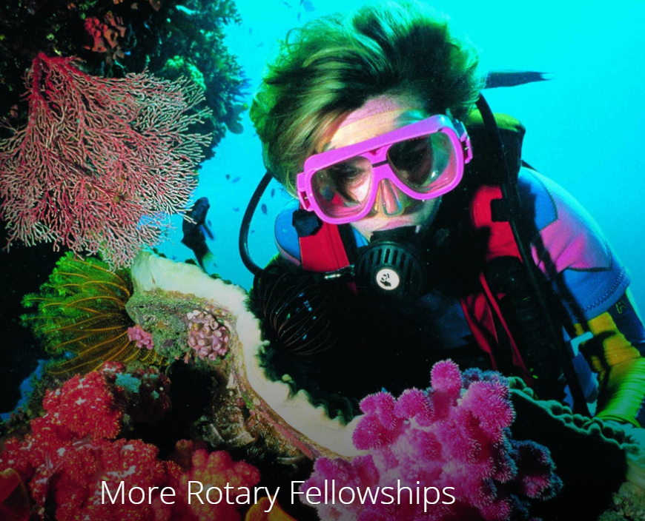
Fellowships
Rotary Fellowships are international groups that share a common passion. Here is a sampling
Antique Automobiles
Bird Watching
Environment
Past District Governors
Peace Fellows
Cruising
Russian Culture
Hiking
Wine

Slide 65
Resources
www.rotary.org
rotaract@rotary.org
Interact@rotary.org
My Rotary https://my.rotary.org/en/
Club Central https://rcc.rotary.org/#/dashboard
Learning Center https://learn.rotary.org/members/learn/catalog
Strategic Plan https://my.rotary.org/en/learning-reference/about-rotary/strategic-plan
Brand Center https://brandcenter.rotary.org/en-GB
Rotary Foundation Grants https://my.rotary.org/en/take-action/apply-grants/district-grants
Logos https://brandcenter.rotary.org/en-GB/Logos
Fellowships https://www.rotary.org/en/our-programs/more-fellowships
https://www.facebook.com/rotary/
https://twitter.com/rotary
https://www.linkedin.com/company/rotary-international
https://blog.rotary.org/tag/social-media/
https://site.clubrunner.ca/page/rotary
https://www.dacdb.com/SecLogin.cfm

Slide 66
QUESTIONS

